Slide 1
Basic Communication Operations
Ananth Grama, Anshul Gupta, George Karypis, and Vipin Kumar
To accompany the text ``Introduction to Parallel Computing'', Addison Wesley, 2003

Slide 2
Topic Overview
One-to-All Broadcast and All-to-One Reduction
All-to-All Broadcast and Reduction
All-Reduce and Prefix-Sum Operations
Scatter and Gather
All-to-All Personalized Communication
Circular Shift
Improving the Speed of Some Communication Operations

Slide 3
Basic Communication Operations: Introduction
Processes need to exchange data. This exchange of data can significantly impact the efficiency of parallel prog.by introducing interaction delays
Many interactions in practical parallel programs occur in well-defined patterns involving groups of processes.
Efficient implementations of these operations can improve performance, reduce development effort and cost, and improve software quality.
Efficient implementations must influence underlying architecture. For this reason, we refer to specific architectures here.
We select a descriptive set of architectures to illustrate the process of algorithm design.

Slide 4
Basic Communication Operations: Introduction
Group communication operations are built using point-to-point messaging primitives.
Recall from our discussion of architectures that communicating a message of size m over an uncongested network takes time t_{s} +t_{m}w.
We use this as the basis for our analyses. Where necessary, we take congestion into account explicitly by scaling the t_{w} term.
We assume that the network is bidirectional and that communication is single-ported.two directly connected nodes can send message to each other simultaneously. Node can send message only one of its links at a time

Slide 5
One-to-All Broadcast and All-to-One Reduction
One processes has a piece of data (of size m) it needs to send to everyone. Known as one to all broadcast
The dual of one-to-all broadcast is all-to-one reduction.
In all-to-one reduction, each processor has m units of data. These data items must be combined piece-wise (using some associative operator, such as addition or min), and the result made available at a target process.

Slide 6
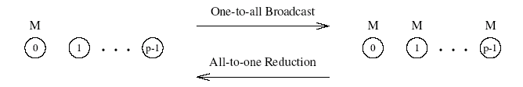
One-to-All Broadcast and All-to-One Reduction
One-to-all broadcast and all-to-one reduction among processors.

Slide 7
One-to-All Broadcast and All-to-One Reduction on Rings
Simplest way is to send p-1 messages from the source to the other p-1 processes - this is not very efficient.
Use recursive doubling: source sends a message to a selected process. Now both these processes can simultaneously send the message to two other processes. Continuing till all processes have message. It take log p stages
We now have two independent problems derined over halves of machines.
Reduction can be performed in an identical fashion by inverting the process.

Slide 8
One-to-All Broadcast and All-to-One Reduction on Rings
Message is first send to farthest node 4 from source 0. in second step distance between sending and receiving nodes is halved and so on. Reduce congestion
Reduction can be performed in an identical fashion by inverting the process. i.e. reversing the direction and sequence of communication.
In first step all odd numbers node sends its buffer to even numbered node
Second step buffer on node 2 and 0 are accumulated to node 0 and node 6 and 4 are accumulated to 4.
Finally 4 sends to 0 which computes result

Slide 9
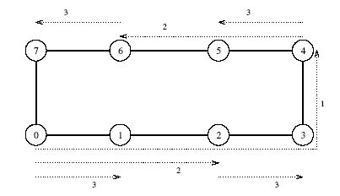
One-to-All Broadcast
One-to-all broadcast on an eight-node ring. Node 0 is the source of the broadcast. Each message transfer step is shown by a numbered, dotted arrow from the source of the message to its destination. The number on an arrow indicates the time step during which the message is transferred.

Slide 10
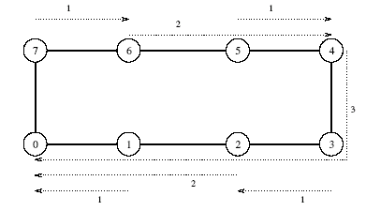
All-to-One Reduction
Reduction on an eight-node ring with node 0 as the destination of the reduction.

Slide 11
Broadcast and Reduction: Example
Consider the problem of multiplying a matrix with a vector.
The n x n matrix is assigned to an n x n (virtual) processes grid. The vector is assumed to be on the first row of processes.
The first step of the product requires a one-to-all broadcast of the vector element along the corresponding column of processes. This can be done concurrently for all n columns.
The processes compute local product of the vector element and the local matrix entry.
In the final step, the results of these products are accumulated to the first row using n concurrent all-to-one reduction operations along the columns (using the sum operation).

Slide 12
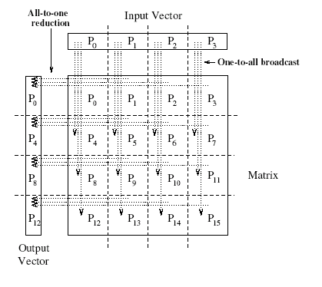
Broadcast and Reduction: Matrix-Vector Multiplication Example
One-to-all broadcast and all-to-one reduction in the multiplication of a 4 x 4 matrix with a 4 x 1 vector.

Slide 13
Broadcast and Reduction on a Mesh
We can view each row and column of a square mesh of p nodes as a linear array of √p nodes.
Broadcast and reduction operations can be performed in two steps - the first step does the operation along a row and the second step along each column concurrently.
This process generalizes to higher dimensions as well.

Slide 14
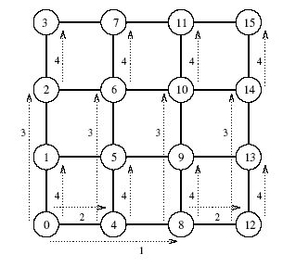
Broadcast and Reduction on a Mesh: Example
One-to-all broadcast on a 16-node mesh.

Slide 15
Broadcast and Reduction on a Hypercube
A hypercube with 2^{d} nodes can be regarded as a d-dimensional mesh with two nodes in each dimension.
The mesh algorithm can be generalized to a hypercube and the operation is carried out in d (= log p) steps.

Slide 16
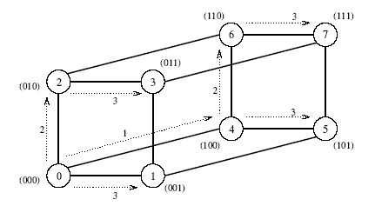
Broadcast and Reduction on a Hypercube: Example
One-to-all broadcast on a three-dimensional hypercube. The binary representations of node labels are shown in parentheses.

Slide 17
Broadcast and Reduction on a Balanced Binary Tree
Consider a binary tree in which processes are (logically) at the leaves and internal nodes are routing nodes.
Assume that source process is the root of this tree. In the first step, the source sends the data to the right child (assuming the source is also the left child). The problem has now been decomposed into two problems with half the number of processes.

Slide 18
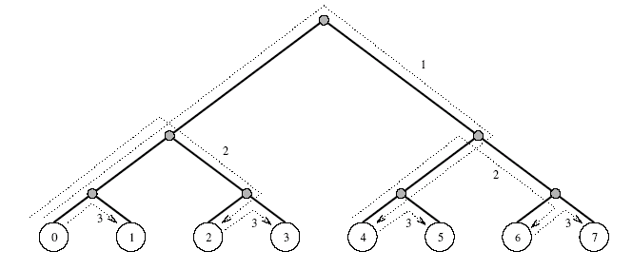
Broadcast and Reduction on a Balanced Binary Tree
One-to-all broadcast on an eight-node tree.

Slide 19
Broadcast and Reduction Algorithms
All of the algorithms described above are adaptations of the same algorithmic template.
We illustrate the algorithm for a hypercube, but the algorithm, as has been seen, can be adapted to other architectures.
The hypercube has 2^{d} nodes and my_id is the label for a node.
X is the message to be broadcast, which initially resides at the source node 0.

Slide 20
Broadcast and Reduction Algorithms
Total d communication steps one along each dimension
Highest to lowest dimension
i indicates current dimension. Only the node with zero in the i least significant bits participate in communication along dimension I
Node with zero at bit position I send data and node with one at bit position i receive it
E.g.i=2 0 and 4
i=1 0 and 4 sender 2 and 6 are receiver

Slide 21
Broadcast and Reduction Algorithms
For arbitrary source we must relabel the nodes by xor the label of each node with the label of the source node
So source node label become zero and relables the other nodes relative to the source

Slide 22
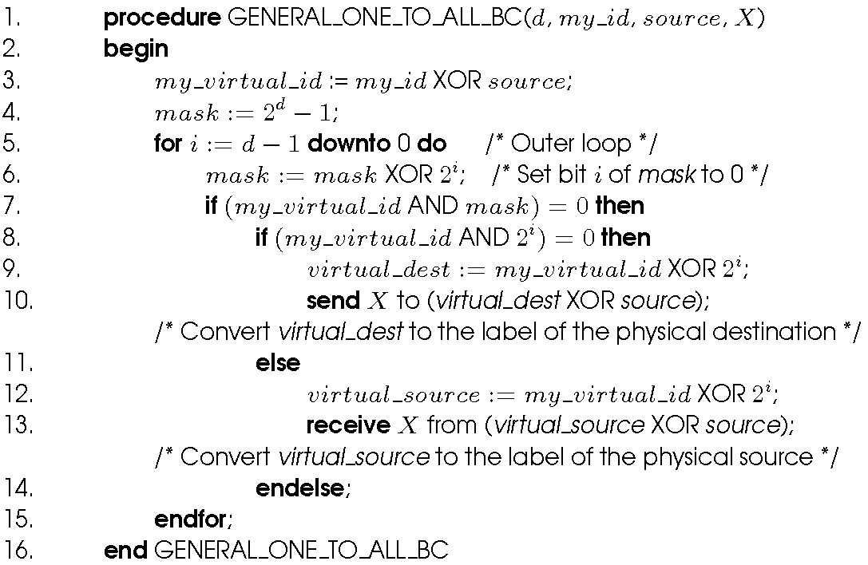
Broadcast and Reduction Algorithms
One-to-all broadcast of a message X from source on a hypercube.

Slide 23
Broadcast and Reduction Algorithms
Reduction by reversing the order and the direction of messages
From lowest to highest dimension. Criteria for source and destination is also reversed

Slide 24
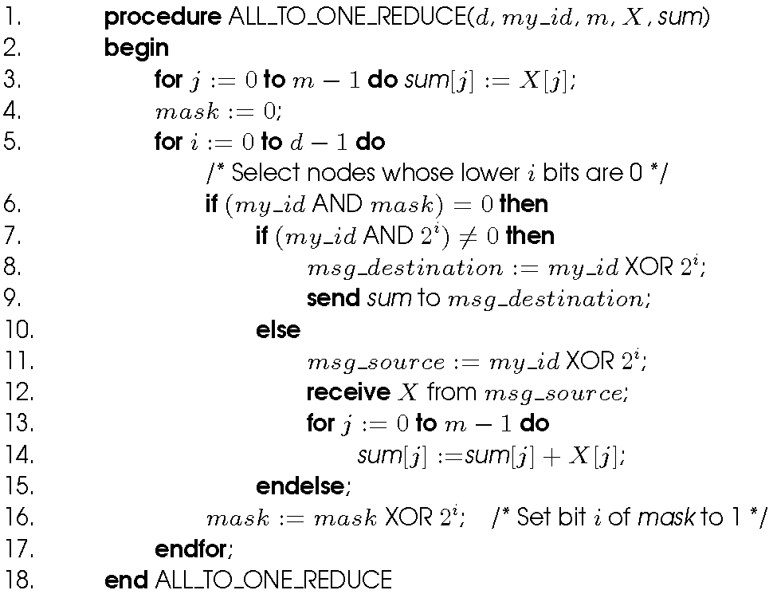
Broadcast and Reduction Algorithms
Single-node accumulation on a d-dimensional hypercube. Each node contributes a message X containing m words, and node 0 is the destination.

Slide 25

Cost Analysis
The broadcast or reduction procedure involves log p point-to-point simple message transfers, each at a time cost of t_{s} + t_{w}m.
The total time is therefore given by:

Slide 26
All-to-All Broadcast and Reduction
Generalization of broadcast in which each process is the source as well as destination.
A process sends the same m-word message to every other process, but different processes may broadcast different messages.
Used in matrix operations

Slide 27
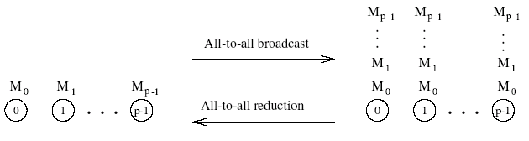
All-to-All Broadcast and Reduction
All-to-all broadcast and all-to-all reduction.

Slide 28
All-to-All Broadcast and Reduction on a Ring
Simplest approach: perform p one-to-all broadcasts. This is not the most efficient way, though.
Each node first sends to one of its neighbors the data it needs to broadcast.
In subsequent steps, it forwards the data received from one of its neighbors to its other neighbor.
The algorithm terminates in p-1 steps.

Slide 29
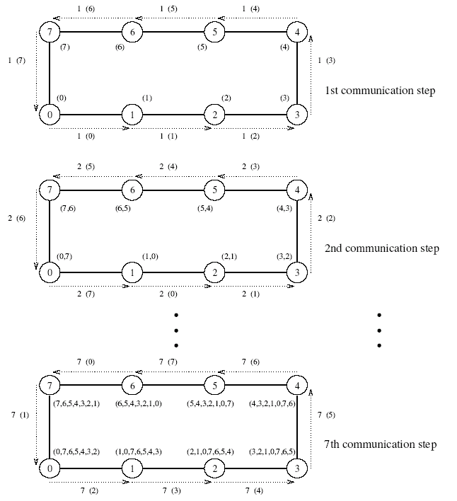
All-to-All Broadcast and Reduction on a Ring
e.g. between 0 and 1 arc labeled as 2(7) indicates in time 2 that node 0 receive from 7
All-to-all broadcast on an eight-node ring.

Slide 30
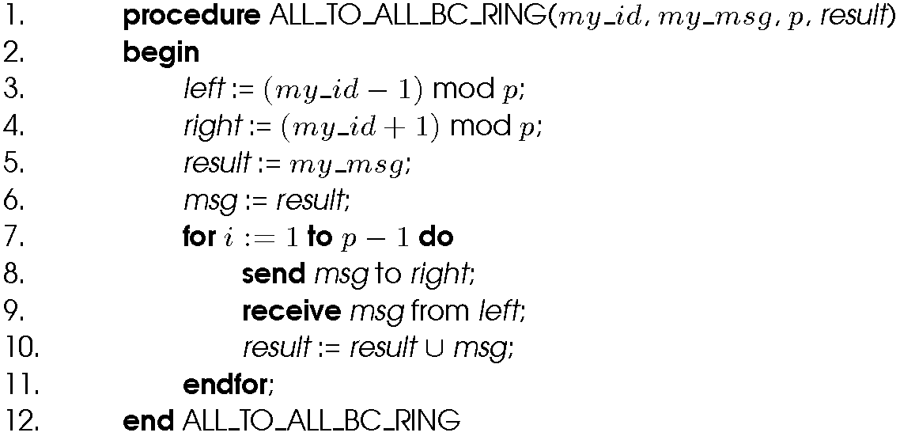
All-to-All Broadcast and Reduction on a Ring
All-to-all broadcast on a p-node ring.

Slide 31
All-to-All Broadcast and Reduction on a Ring
Reverse the direction and sequence of messages
E.g. node 0 sending msg[1] to 7 instead of receiving it
Upon receiving a message a node must combine it with the local copy of the message that has the same destination as the received message before forwarding the combined message to next neighbor

Slide 32
All-to-all Broadcast on a Mesh
Performed in two phases - in the first phase, each row of the mesh performs an all-to-all broadcast using the procedure for the linear array.
In this phase, all nodes collect √p messages corresponding to the √p nodes of their respective rows. Each node consolidates this information into a single message of size m√p.
The second communication phase is a columnwise all-to-all broadcast of the consolidated messages.

Slide 33
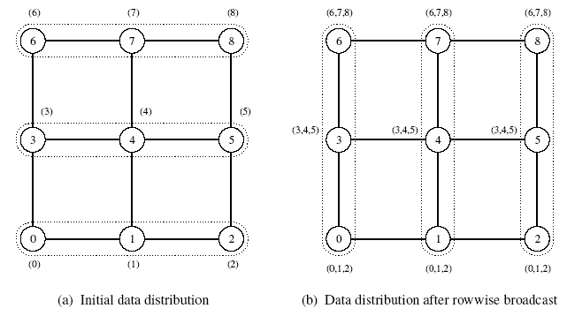
All-to-all Broadcast on a Mesh
All-to-all broadcast on a 3 x 3 mesh. The groups of nodes communicating with each other in each phase are enclosed by dotted boundaries. By the end of the second phase, all nodes get (0,1,2,3,4,5,6,7) (that is, a message from each node).

Slide 34
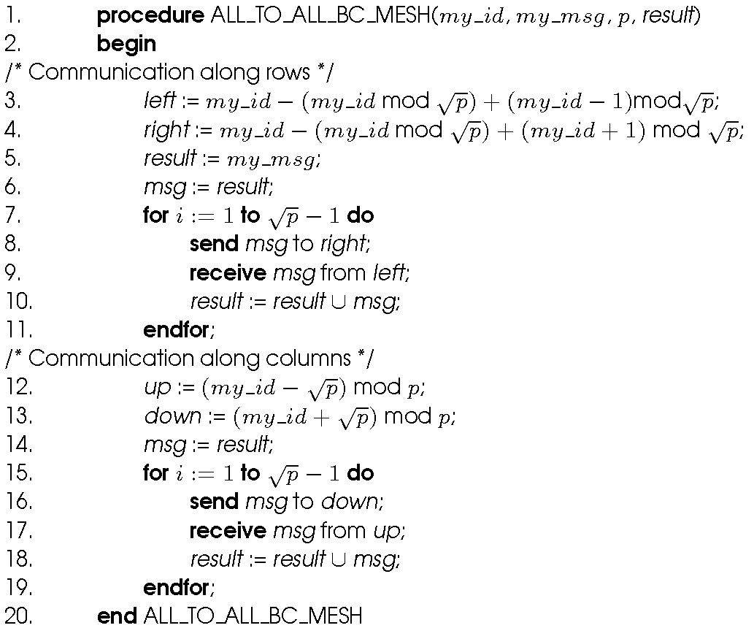
All-to-all Broadcast on a Mesh
All-to-all broadcast on a square mesh of p nodes.

Slide 35
All-to-all broadcast on a Hypercube
Generalization of the mesh algorithm to log p dimensions.
Message size doubles at each of the log p steps.
Communication starts from the lowest dimension of the hypercube and then proceeds along successively higher dimensions

Slide 36
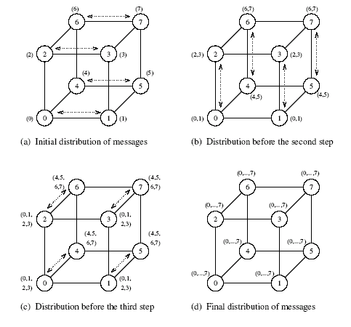
All-to-all broadcast on a Hypercube
All-to-all broadcast on an eight-node hypercube.

Slide 37
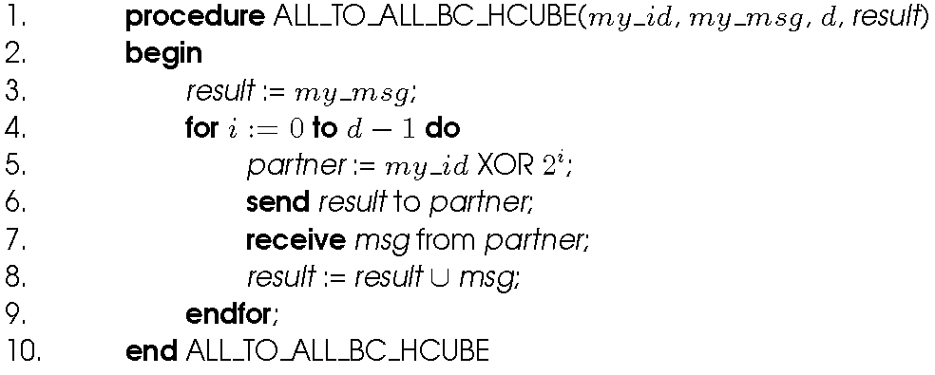
All-to-all broadcast on a Hypercube
All-to-all broadcast on a d-dimensional hypercube.

Slide 38
All-to-all Reduction
Similar communication pattern to all-to-all broadcast, except in the reverse order.
On receiving a message, a node must combine it with the local copy of the message that has the same destination as the received message before forwarding the combined message to the next neighbor.

Slide 39
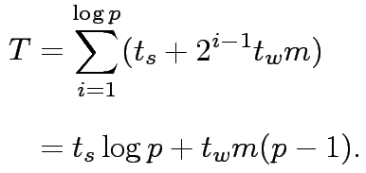
Cost Analysis
On a ring, the time is give by: (t_{s} + t_{w}m)(p-1).
Om mesh first phase √p processes. In second pahse also √p but message is now m √p
On a mesh, the time is given by: 2t_{s}(√p – 1) + t_{w}m(p-1).
On a hypercube, we have:

Slide 40
All-to-all broadcast: Notes
Large messages highly connected network like hypercube is no better than simple ring
It is not possible to port algorithms for higher dimensional networks (such as a hypercube) into a ring because this would cause contention.

Slide 41
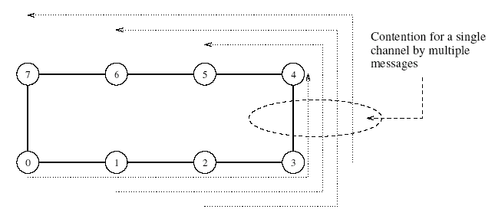
All-to-all broadcast: Notes
Contention for a channel when the hypercube is mapped onto a ring.

Slide 42
All-Reduce and Prefix-Sum Operations
In all-reduce, each node starts with a buffer of size m and the final results of the operation are identical buffers of size m on each node that are formed by combining the original p buffers using an associative operator.
Identical to all-to-one reduction followed by a one-to-all broadcast. This formulation is not the most efficient. Uses the pattern of all-to-all broadcast, instead. The only difference is that message size does not increase here. Time for this operation is (t_{s} + t_{w}m) log p.
Different from all-to-all reduction, in which p simultaneous all-to-one reductions take place, each with a different destination for the result.

Slide 43
All-Reduce and Prefix-Sum Operations
With a single word message on each node is used to implement barrier synchronization on a message passing
While executing a parallel algorithm no node can finish the reduction before each node has contributed a value
e.g. let integer shown in parentheses is number rather than message

Slide 44
The Prefix-Sum Operation
Prefix sum (scan) is another important problem that can be solved using all reduce operation
Given p numbers n₀,n₁,…,n_{p-1} (one on each node), the problem is to compute the sums s_{k} = ∑_{i}^{k}₌ ₀ n_{i} for all k between 0 and p-1 .
Initially, n_{k} resides on the node labeled k, and at the end of the procedure, the same node holds S_{k}.
E.g. (3,1,4,0,2)
Prefix sum (3,4,8,8,10)

Slide 45
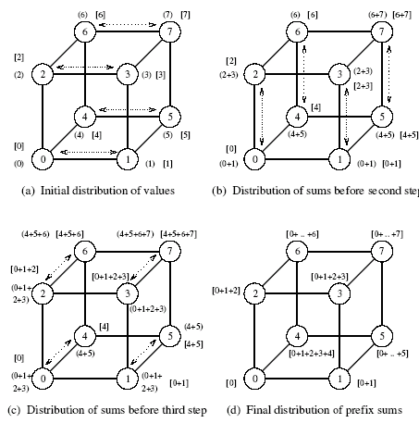
The Prefix-Sum Operation
Computing prefix sums on an eight-node hypercube. At each node, square brackets show the local prefix sum accumulated in the result buffer and parentheses enclose the contents of the outgoing message buffer for the next step.

Slide 46
The Prefix-Sum Operation
The operation can be implemented using the all-to-all broadcast kernel.
We must account for the fact that in prefix sums the node with label k uses information from only the k-node subset whose labels are less than or equal to k.
This is implemented using an additional result buffer. buffer is denoted with square bracket. The content of an incoming message is added to the result buffer only if the message comes from a node with a smaller label than the recipient node.
The contents of the outgoing message (denoted by parentheses in the figure) are updated with every incoming message.

Slide 47
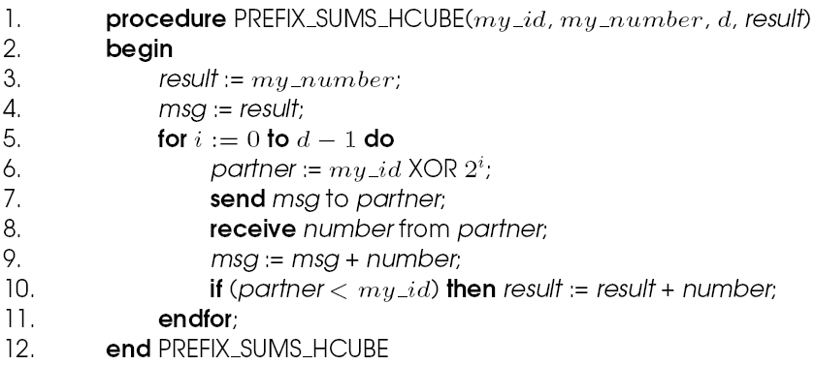
The Prefix-Sum Operation
Prefix sums on a d-dimensional hypercube.

Slide 48
Scatter and Gather
In the scatter operation, a single node sends a unique message of size m to every other node (also called a one-to-all personalized communication)
Different from one to all broadcast: source node start with p unique messages
In the gather operation, a single node collects a unique message from each node.
While the scatter operation is fundamentally different from broadcast, the algorithmic structure is similar, except for differences in message sizes (messages get smaller in scatter and stay constant in broadcast).
The gather operation is exactly the inverse of the scatter operation and can be executed as such.

Slide 49
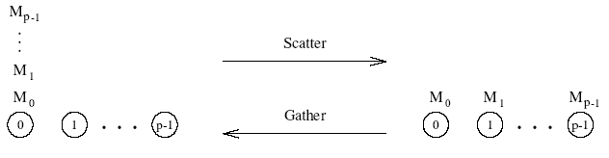
Gather and Scatter Operations
Scatter and gather operations.

Slide 50
Scatter and Gather
In first communication step source transfer half of the messages to one of its neighbour
Total log p communication steps
Gather : odd node sends to an even number node

Slide 51
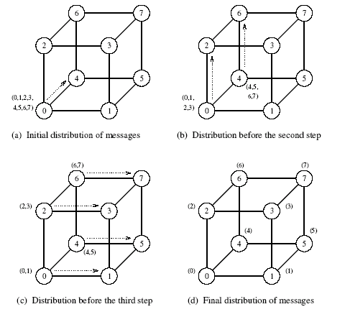
Example of the Scatter Operation
The scatter operation on an eight-node hypercube.

Slide 52

Cost of Scatter and Gather
There are log p steps, in each step, the machine size halves and the data size halves.
We have the time for this operation to be:
This time holds for a linear array as well as a 2-D mesh.

Slide 53
All-to-All Personalized Communication
Each node has a distinct message of size m for every other node.
This is unlike all-to-all broadcast, in which each node sends the same message to all other nodes.
All-to-all personalized communication is also known as total exchange.
Equivalent to transposing a Two dimensional array of data distributed among p processes using one dimensional array partitioning

Slide 54
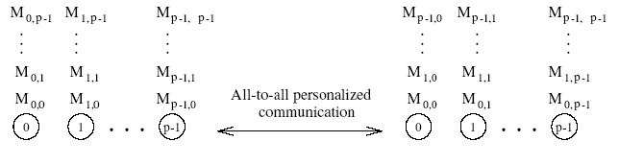
All-to-All Personalized Communication
All-to-all personalized communication.

Slide 55
All-to-All Personalized Communication: Example
Consider the problem of transposing a matrix.
Each processor contains one full row of the matrix.
The transpose operation in this case is identical to an all-to-all personalized communication operation.

Slide 56
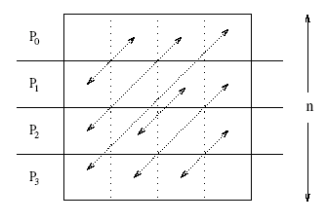
All-to-All Personalized Communication: Example
All-to-all personalized communication in transposing a 4 x 4 matrix using four processes.

Slide 57
All-to-All Personalized Communication on a Ring
Each node sends all pieces of data as one consolidated message of size m(p – 1) to one of its neighbors.
Each node extracts the information meant for it from the data received, and forwards the remaining (p – 2) pieces of size m each to the next node.
The algorithm terminates in p – 1 steps.
The size of the message reduces by m at each step.

Slide 58
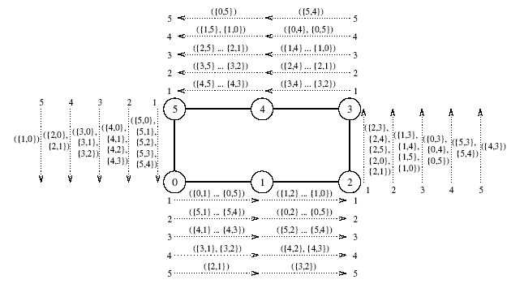
All-to-All Personalized Communication on a Ring
All-to-all personalized communication on a six-node ring. The label of each message is of the form {x,y}, where x is the label of the node that originally owned the message, and y is the label of the node that is the final destination of the message. The label ({x₁,y₁}, {x₂,y₂},…, {x_{n},y_{n}}, indicates a message that is formed by concatenating n individual messages.

Slide 59
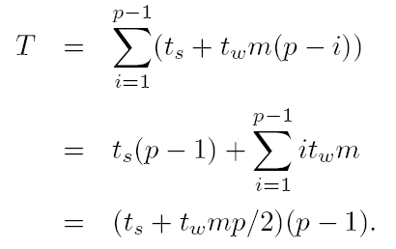
All-to-All Personalized Communication on a Ring: Cost
We have p – 1 steps in all.
In step i, the message size is m(p – i).
The total time is given by:
The t_{w} term in this equation can be reduced by a factor of 2 by communicating messages in both directions.

Slide 60
All-to-All Personalized Communication on a Mesh
Each node first groups its p messages according to the columns of their destination nodes.
All-to-all personalized communication is performed independently in each row with clustered messages of size m√p.
Messages in each node are sorted again, this time according to the rows of their destination nodes.
All-to-all personalized communication is performed independently in each column with clustered messages of size m√p.

Slide 61
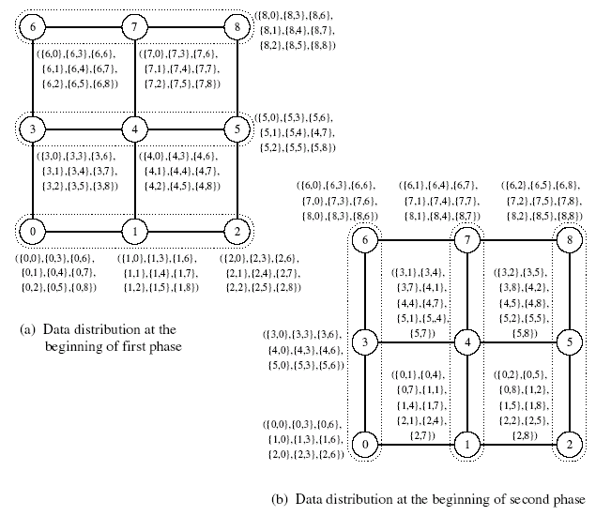
All-to-All Personalized Communication on a Mesh
The distribution of messages at the beginning of each phase of all-to-all personalized communication on a 3 x 3 mesh. At the end of the second phase, node i has messages ({0,i},…,{8,i}), where 0 ≤ i ≤ 8. The groups of nodes communicating together in each phase are enclosed in dotted boundaries.

Slide 62

All-to-All Personalized Communication on a Mesh: Cost
Time for the first phase is identical to that in a ring with √p processors, i.e., (t_{s} + t_{w}mp/2)(√p – 1).
Time in the second phase is identical to the first phase. Therefore, total time is twice of this time, i.e.,
Here we have not considered sorting time. Let tr is time to perform read and write on a single word. So total time trmp. This time is much smaller than communication time

Slide 63
All-to-All Personalized Communication on a Hypercube
Generalize the mesh algorithm to log p steps.
At any stage in all-to-all personalized communication, every node holds p packets of size m each.
While communicating in a particular dimension, every node sends p/2 of these packets (consolidated as one message). Destination of these packets are the nodes of the other subcube connected by the links in current dimension
A node must rearrange its messages locally before each of the log p communication steps.

Slide 64
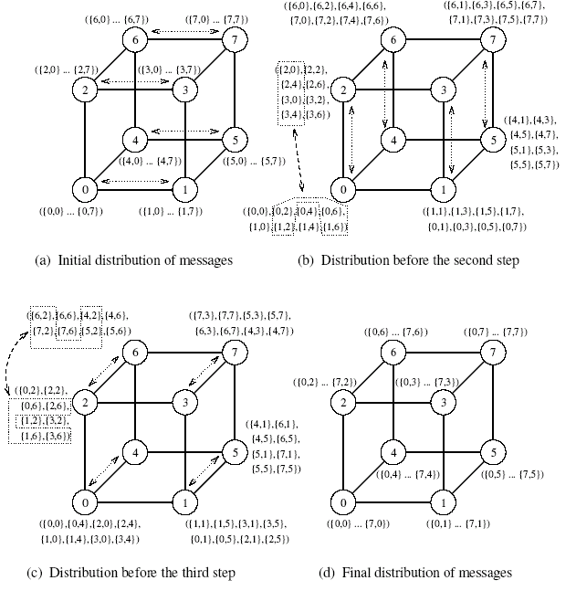
All-to-All Personalized Communication on a Hypercube
An all-to-all personalized communication algorithm on a three-dimensional hypercube.

Slide 65

All-to-All Personalized Communication on a Hypercube: Cost
We have log p iterations and mp/2 words are communicated in each iteration. Therefore, the cost is:
Each node arrange mp words. So total time t_{r}mplogp
This is not optimal! Because lower bound is
T_{w}m(p-1)
Each of p nodes sends and receives m(p-1)words. average distance bet any two nodes is (log p) /2. so total traffic is pm(p-1)(log p)/2. total link is (p *log p) /2
x

Slide 66
All-to-All Personalized Communication on a Hypercube: Optimal Algorithm
Each node simply performs p – 1 communication steps, exchanging m words of data with a different node in every step.
A node must choose its communication partner in each step so that the hypercube links do not suffer congestion.
In the j^{th} communication step, node i exchanges data with node (i XOR j). This routing scheme is e-cube routing
In this schedule, all paths in every communication step are congestion-free, and none of the bidirectional links carry more than one message in the same direction.

Slide 67
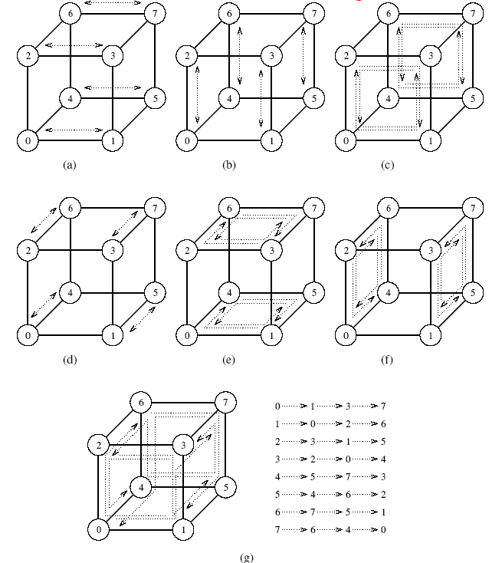
All-to-All Personalized Communication on a Hypercube: Optimal Algorithm
Seven steps in all-to-all personalized communication on an eight-node hypercube.

Slide 68
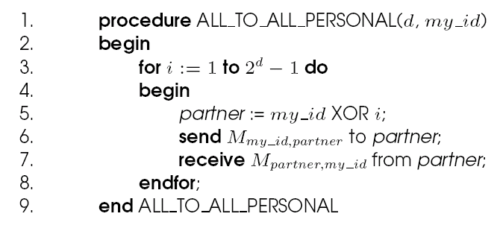
All-to-All Personalized Communication on a Hypercube: Optimal Algorithm
A procedure to perform all-to-all personalized communication on a d-dimensional hypercube. The message M_{i,j} initially resides on node i and is destined for node j.

Slide 69

All-to-All Personalized Communication on a Hypercube: Cost Analysis of Optimal Algorithm
There are p – 1 steps and each step involves non-congesting message transfer of m words.
We have:
Term associated with ts is higher in this equation compare to previous. So small messages the start up time may dominate and first algorithm may be better

Slide 70
Circular Shift
It is a member of broader class of global communication known as permutation
A permutation is a simultaneous one to one data redistribution operation in which each node sends a packet of m words to a unique node
A special permutation in which node i sends a data packet to node (i + q) mod p in a p-node ensemble
(0 ≤ q ≤ p), is known as circular shift.

Slide 71

Circular Shift on a Mesh
The implementation on a ring is rather intuitive. It can be performed in min{q,p – q} neighbor communications.
Mesh algorithms follow from this as well. We shift in one direction (all processors) followed by the next direction.
first entire set of data is shifted q mod √p steps along the rows. Then it is shifted by q / √p steps along the columns. Let q=5 and p=16. one additional column shift is required
The associated time has an upper bound of:

Slide 72
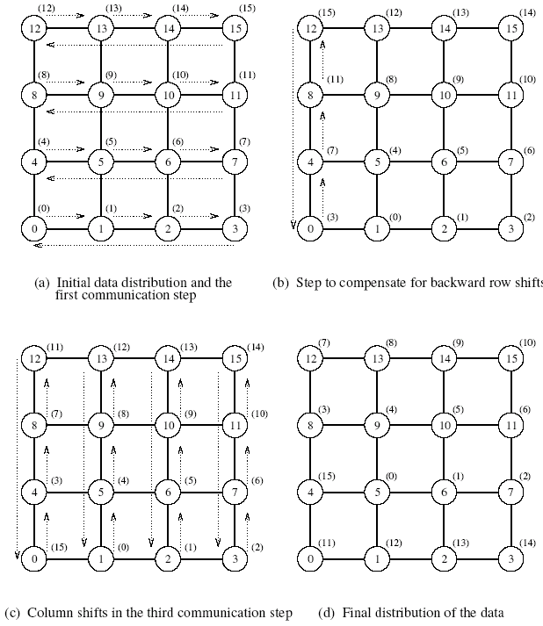
Circular Shift on a Mesh
The communication steps in a circular 5-shift on a 4 x 4 mesh.

Slide 73


Circular Shift on a Hypercube
Map a linear array with 2^{d} nodes onto a d-dimensional hypercube.
To perform a q-shift, we expand q as a sum of distinct powers of 2.
If q is the sum of s distinct powers of 2, then the circular q-shift on a hypercube is performed in s phases.
E.g. 5 shift is performed by 4 shift followed by 1 shift. No of phases in q-shift equal to no of ones
The time for this is upper bounded by:
If E-cube routing is used, this time can be reduced to

Slide 74
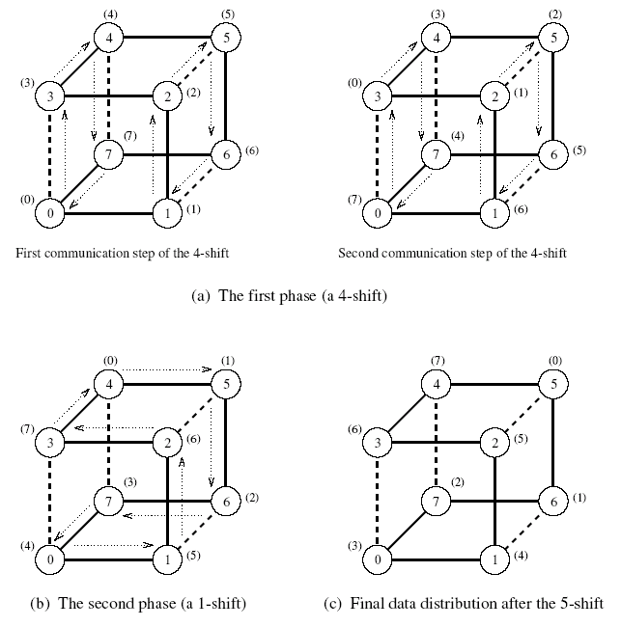
Circular Shift on a Hypercube
The mapping of an eight-node linear array onto a three-dimensional hypercube to perform a circular 5-shift as a combination of a 4-shift and a 1-shift.

Slide 75
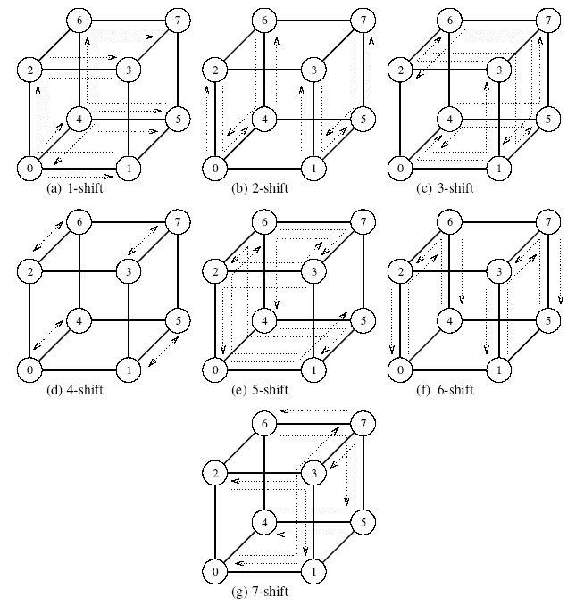
Circular Shift on a Hypercube
Circular q-shifts on an 8-node hypercube for 1 ≤ q < 8.

Slide 76
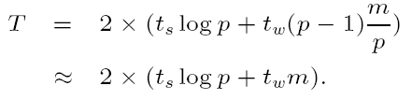
Improving Performance of Operations
Splitting and routing messages into parts: If the message can be split into p parts, a one-to-all broadcast can be implemented as a scatter operation followed by an all-to-all broadcast operation. The time for this is:
All-to-one reduction can be performed by performing all-to-all reduction (dual of all-to-all broadcast) followed by a gather operation (dual of scatter).

Slide 77
Improving Performance of Operations
Since an all-reduce operation is semantically equivalent to an all-to-one reduction followed by a one-to-all broadcast, the asymptotically optimal algorithms for these two operations can be used to construct a similar algorithm for the all-reduce operation.
All to all reduction followed by gather followed by scatter followed by all to all broadcast
The intervening gather and scatter operations cancel each other. Therefore, an all-reduce operation requires an all-to-all reduction and an all-to-all broadcast.
Another way is all port communication

